Slide 1

Workshop on Robotic Simulation
Robo Carnival 2023

Slide 2
Introduction to the software
Interface
Scene, navigation (Pan, rotate, zoom)
Placing basic objects (Move, rotate, scale)
Object properties (Static, Dynamic, Respondable, Non-respondable)
Model Browser – pick and place (Mobile robot, Stationary robot)
Scene Hierarchy
Scripts

Slide 3
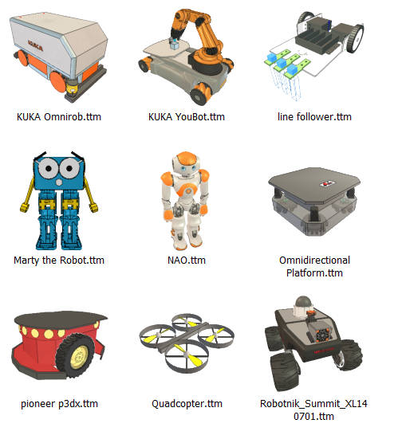
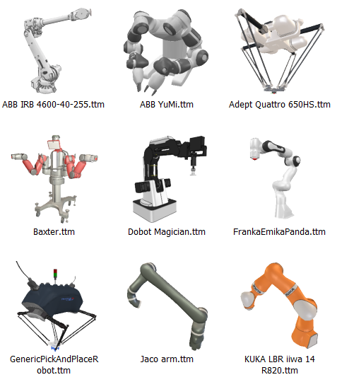
Types of Robots
Mobile Robot
Non-mobile Robot

Slide 4
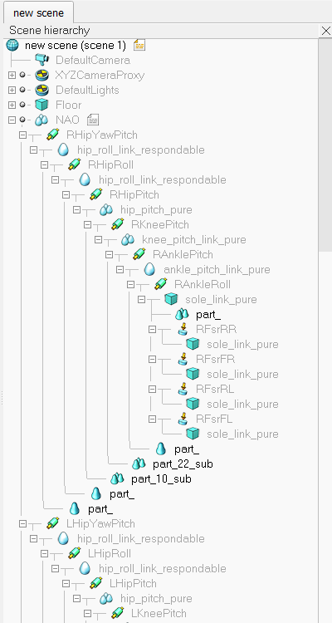

Robot Structure
Scene Hierarchy
Link
Joint

Slide 5
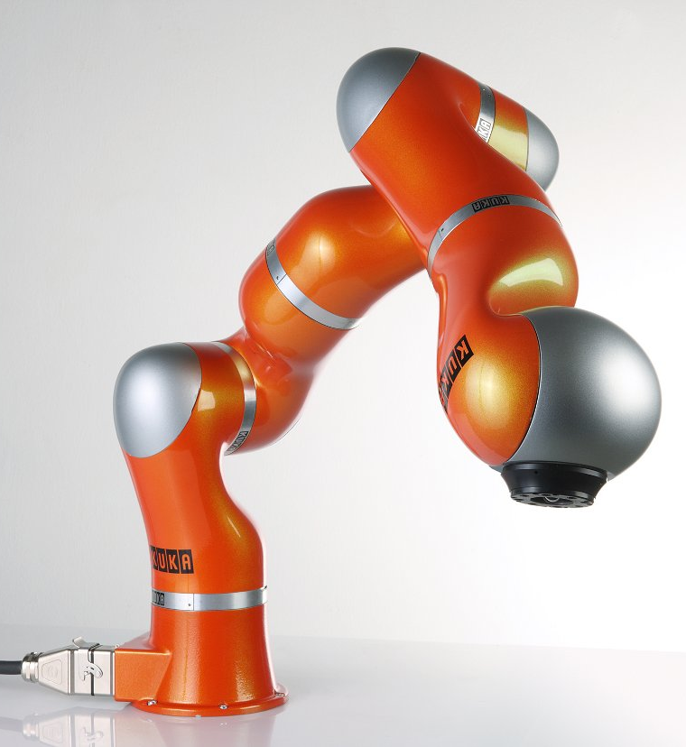
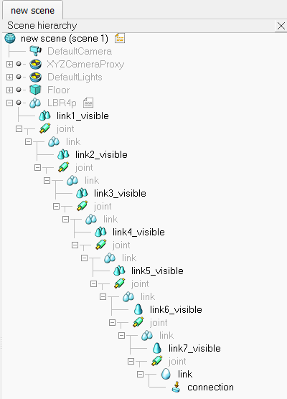
Robot Structure
Scene Hierarchy
Joint
Link

Slide 6
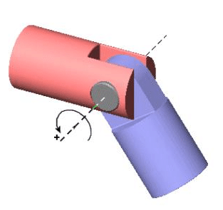
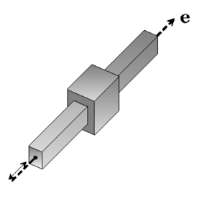
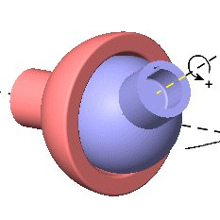
Robot Joints
Revolute Joint (Rotational- 1 Axis)
Prismatic Joint (Translational – 1 Axis)
Spherical Joint
(Rotational- 3 Axis)

Slide 7
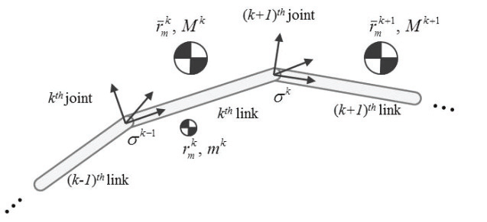
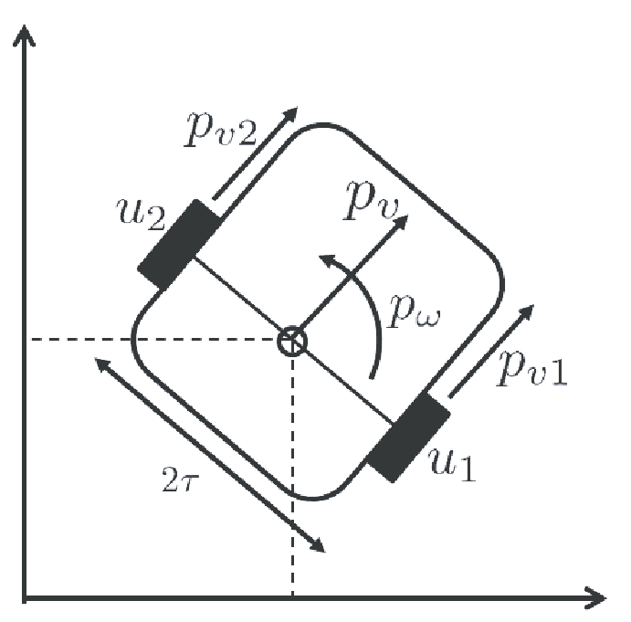
Actuators
Position Control
Velocity Control

Slide 8
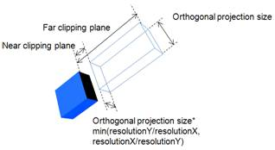
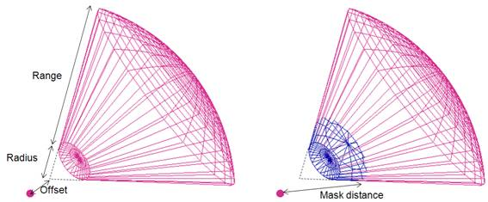
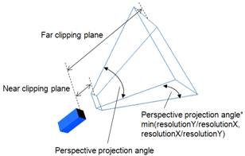
Sensors
Vision Sensor
Proximity/Distance Sensor
Orthographic
Perspective
Equivalent to Ultrasound/IR proximity

Slide 9
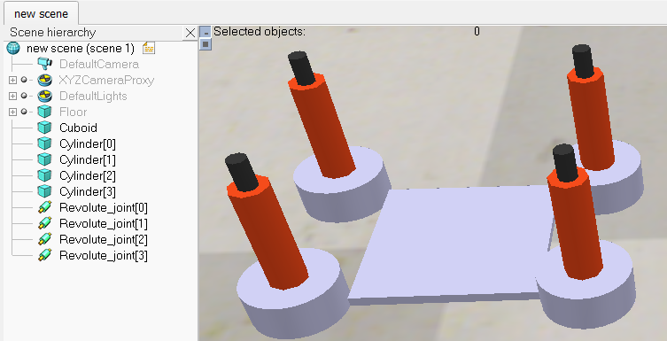
Line Following Robot Build
Body of the Robot (1 Cuboid)
Add > Primitive shape > Cuboid
Dimension (10cm x 10cm x 0.5cm)
Default unit is in meters
Wheels of the Robot (4 Cylinder)
Add > Primitive shape > Cylinder
Dimension (5cm x 2cm)
Motors of the Robot (4 Joints)
Add > Joint > Revolute

Slide 10
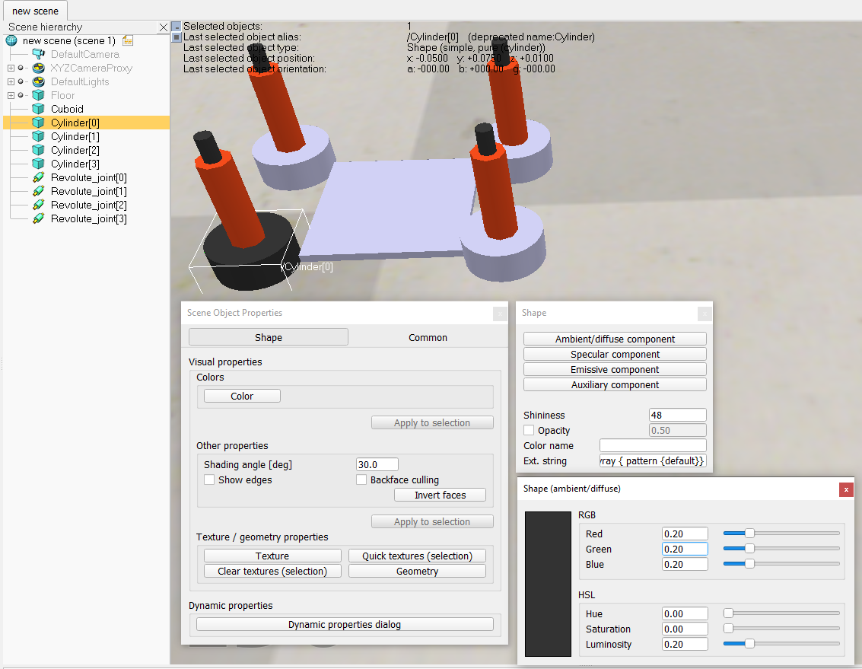
Colors
Double click cuboid icon
Object Properties > Color
Shape > Ambient/diffuse
Components
Adjust color parameters

Slide 11
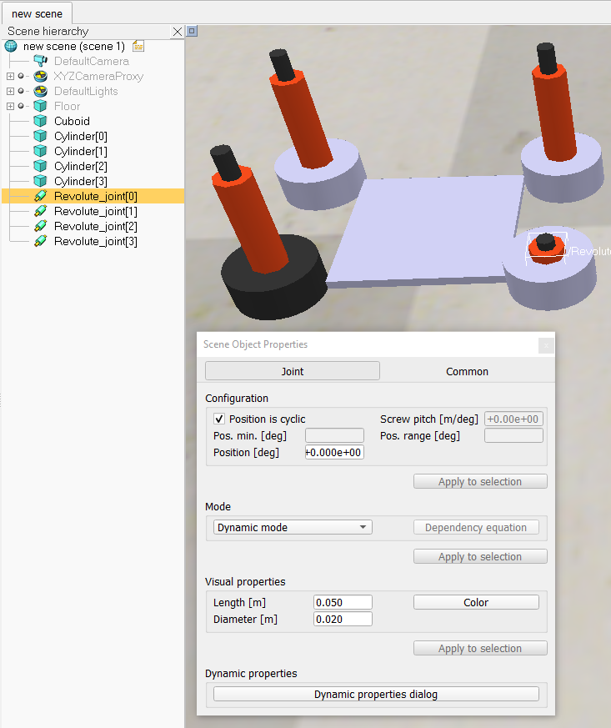
Joints
Double click joint icon
Object Properties > Visual Properties
Adjust the values
This changes appearance only,
no effect on joint behavior

Slide 12
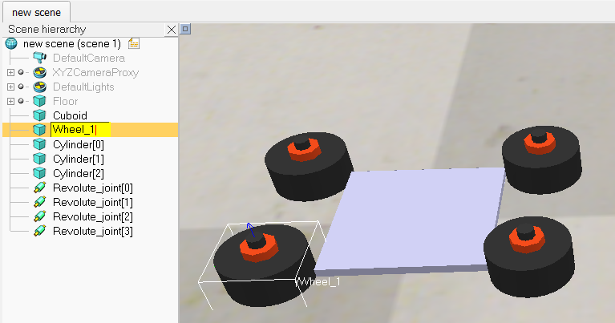
Renaming
Double click on name of object
Set appropriate name
Hit enter to set name

Slide 13
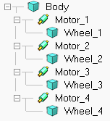
Link-Joint-Link
Drag and drop objects to set the appropriate object hierarchy.
Body should be first link
Joints are child of body
Each wheel is child of a joint

Slide 14
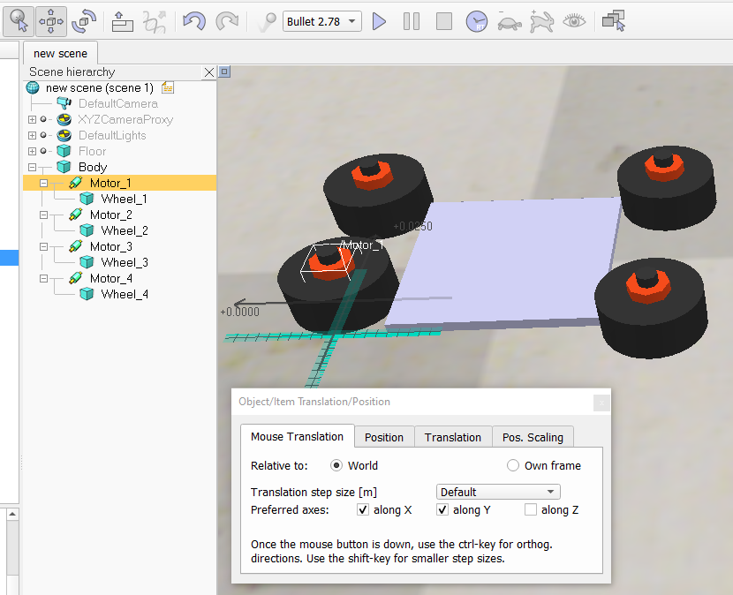
Moving Objects
Select a joint/object
Click on translation icon
With mouse translation tab active,
drag the object around
Child objects will move with parent

Slide 15
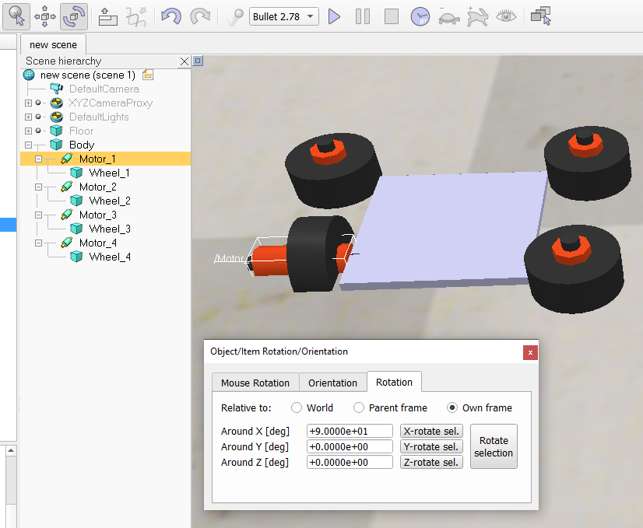
Rotating Objects
Select a joint/object
Click on rotation icon
Go to Rotation tab
Select Own frame
Around X [deg] > 90
Click X-rotate sel

Slide 16
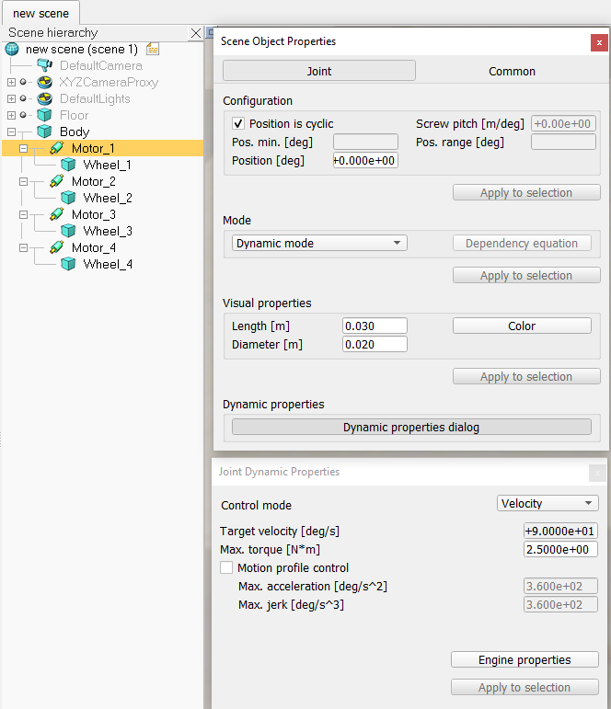
Enable Motor
Double click joint icon
Dynamic properties dialog
Control mode > Velocity
Set velocity to 0

Slide 17
Line Following Robot - Lua
https://www.coppeliarobotics.com/helpFiles/en/lineFollowingBubbleRobTutorial.htm

Slide 18
Line Following Robot - Python
https://www.coppeliarobotics.com/helpFiles/en/remoteApiFunctionsPython.htm

